Slide 1
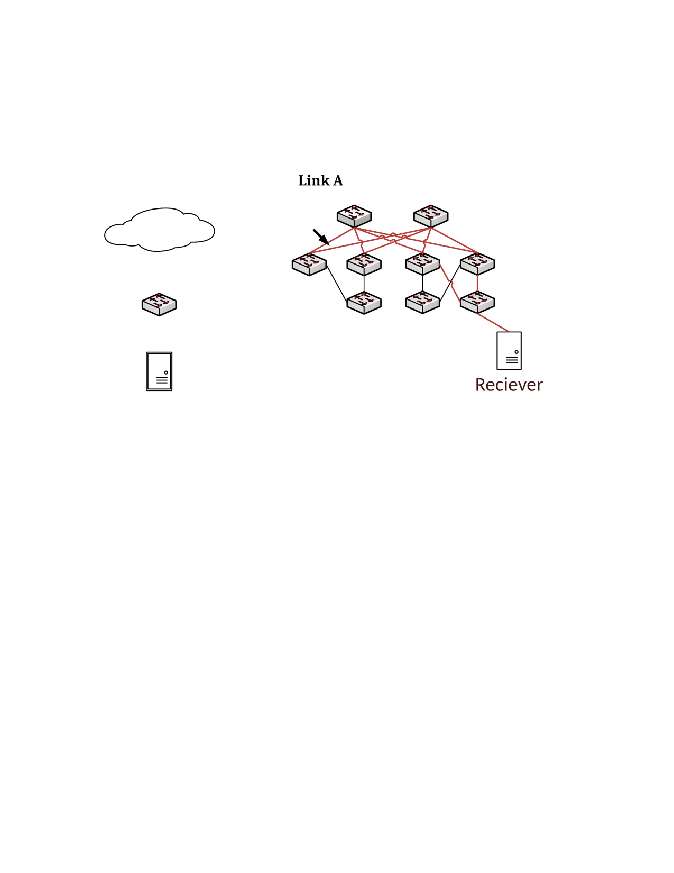
Non-loop deadlock case in Clos network
Core 1
Core 2
Aggr 1
Aggr 2
Aggr 3
Aggr 4
Flow 1
ToR 1
Flow 3
ToR 2
ToR 3
Flow 2
ToR 4
H1: 10.0.0.1
H2: 10.0.1.1
H3: 10.1.0.1
H4: 10.1.1.1

Slide 2
Non-loop deadlock case in Clos network
Flow 3
Aggr2
Core1
Flow 1
tx
rx
rx
tx
tx-1
rx
Core2
Aggr3
Flow 2
tx-2
rx
tx

